Slide 1

Name : Chepkorir Beril
Location : Kenya
Team :Data Science
Date :12/03/2021

Slide 2
Problem Statement
XYZ is a private firm in US. Due to remarkable growth in the Cab Industry in last few years and multiple key players in the market, it is planning for an investment in Cab industry and they want to understand the market before taking final decision.
Objective :Provide actionable insights to help XYZ firm in identifying the right company for making investments

Slide 3
Data Analysis Approach
The analysis has been divided into the following parts
-Data Understanding
-Using various visualization to uncover insights
-Deriving new necessary columns
-Recommendation for investment

Slide 4
Data Understanding
We have 4 datasets :Cab_Data.CSV, Customer_ID.csv,
Transaction_ID.csv and City.csv
Time period of data is from 31/01/2016 to 31/12/2018.

Slide 5
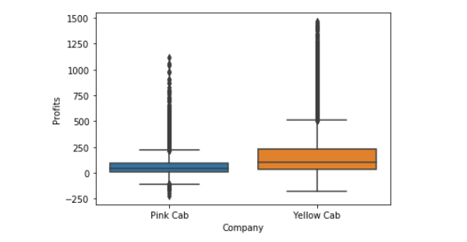
Profit Made by Company
Average profit made by Yellow Cab is
more than that made by Pink Cab

Slide 6
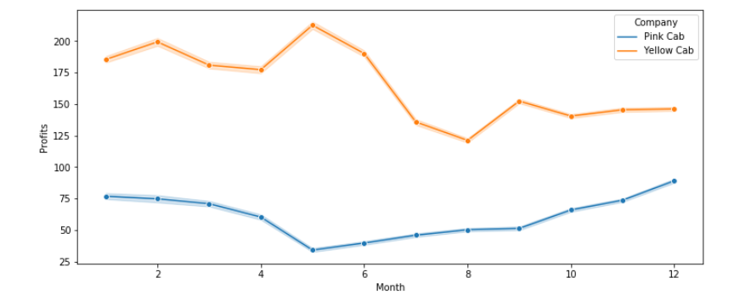
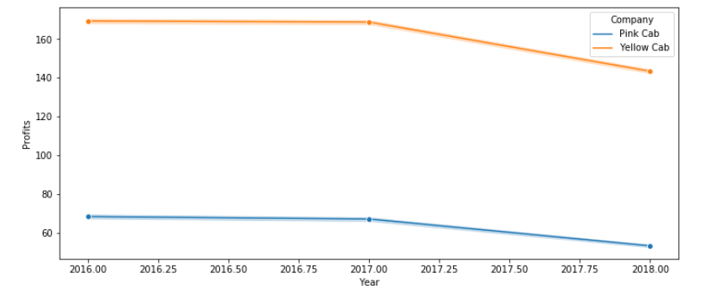
Monthly and Yearly Profits
Monthly profits
Yearly Profits
Yellow Cab has highest profit on 5th month while pink cab made losses on the same month
Yellow cab is leading in profits

Slide 7
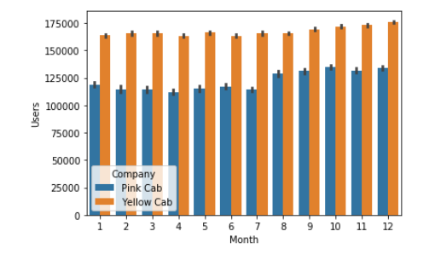
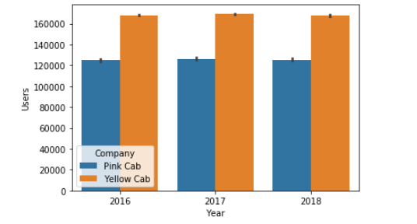
Users Analysis
Montly user analysis
Yearly user analysis
10th ,11th,and 12th has more users being led by Yellow Cab
Both cabs maintained users

Slide 8
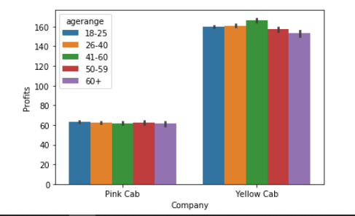
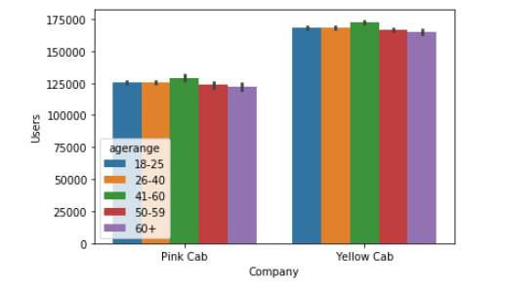
Age Analysis
Age and users
Age and profit
Age 41-46 contribute to more users
In yellow cab age 41-60 contribute more profits while in pink cab it spread across all age ranges

Slide 9
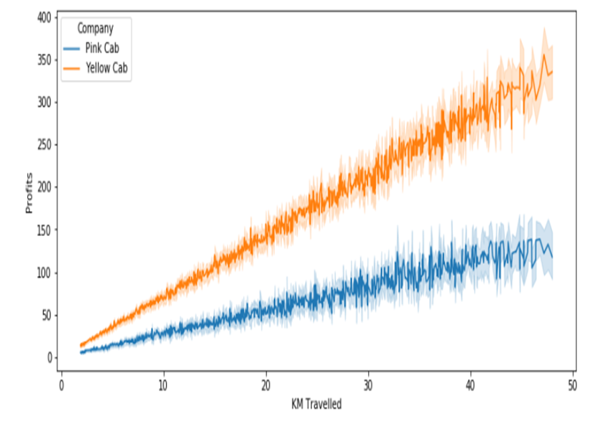
Profit Per KM
Yellow Cab makes more profits per KM travelled .As the KM Travelled increases the profits by both cab increases

Slide 10
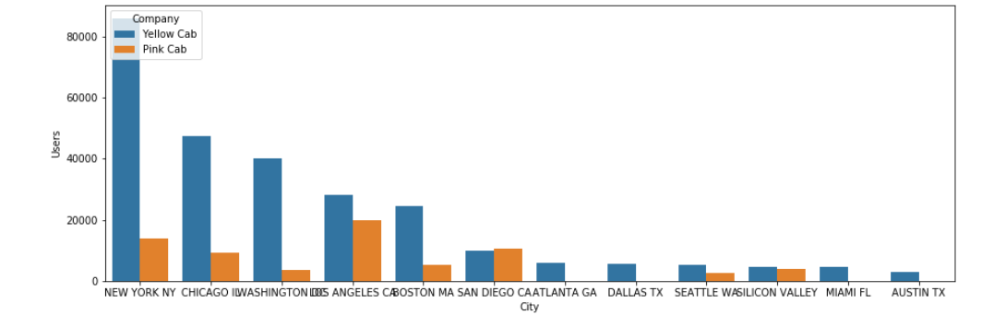
City users analysis
Yellow cab covers majority of the city and has the leading users

Slide 11
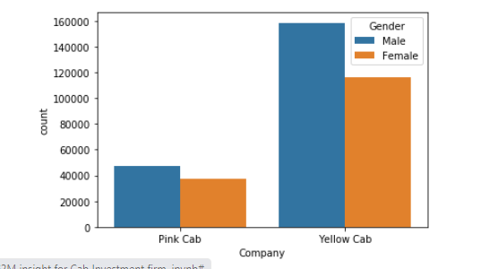
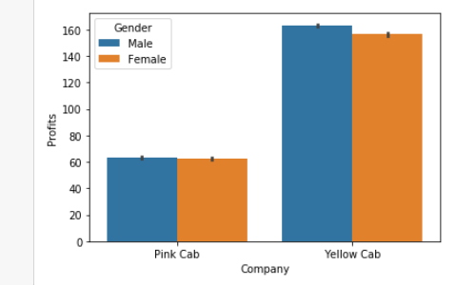
Gender Company analysis
Gender user
Gender profit
Profits made by both male and female are almost equally the same

Slide 12
Recommendation
From the above analysis I concluded that the Yellow Cab is better than the Pink Cab
Profit – Yellow Cab is making more profits both in yearly and in monthly profits
Users - Yellow Cab has more Users than Pink Cab
Gender –Male and female in both companies doesn’t vary much and both pretty much contribute to the profit
Average profit per KM –Average profit per KM for yellow Cab is more than of Pink Cab
On the basis of above points ,I will recommend Yellow Cab for investments

Slide 13

Thank You

